Slide 1
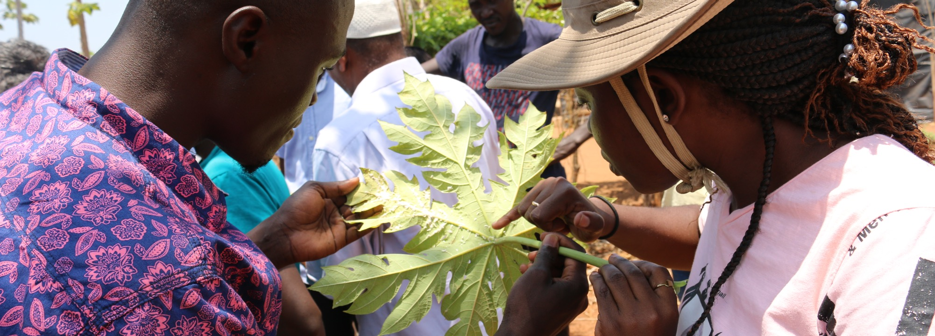
PlantwisePlus

Slide 2
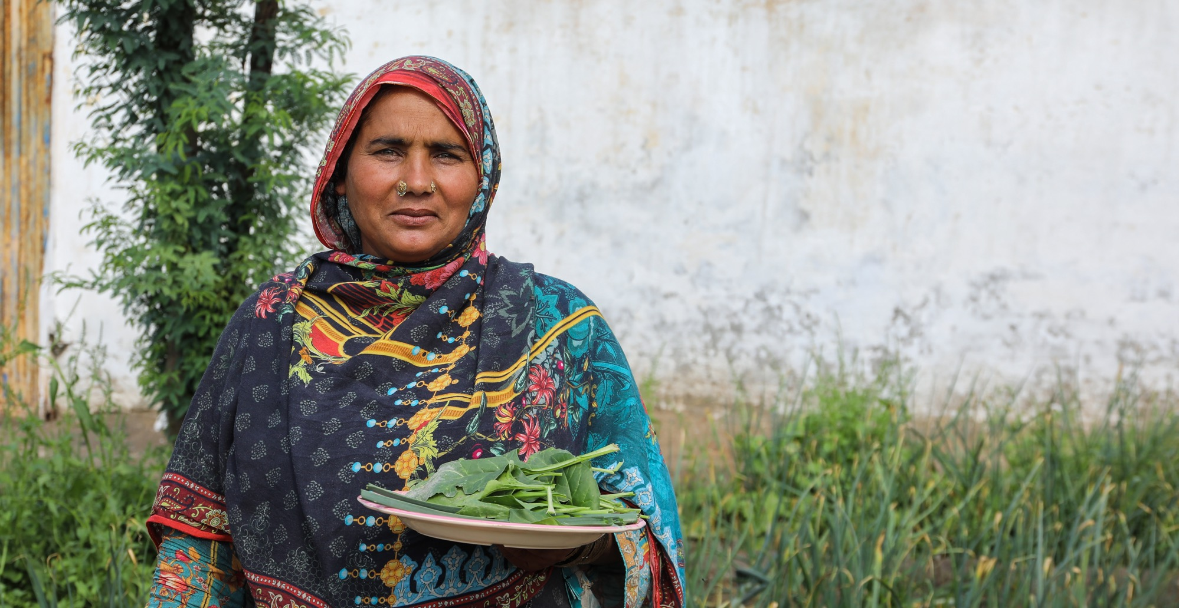








Plantwise Plus (2021-2030): Goal
75 million smallholder farmers in 27 low- and middle-income countries producing more food using safer and sustainable crop production practices, thereby improving food security and rural livelihoods.
Notes:
Contribution to SDGs
Reducing crop losses and supporting income-generating opportunities
Reducing reliance on highly-hazardous pesticides
Facilitating women’s access to advisory services
Climate-resilient plant health advice
Prevention or control of invasive species and protecting biodiversity
Building in-country capacity on plant health threats

Slide 3
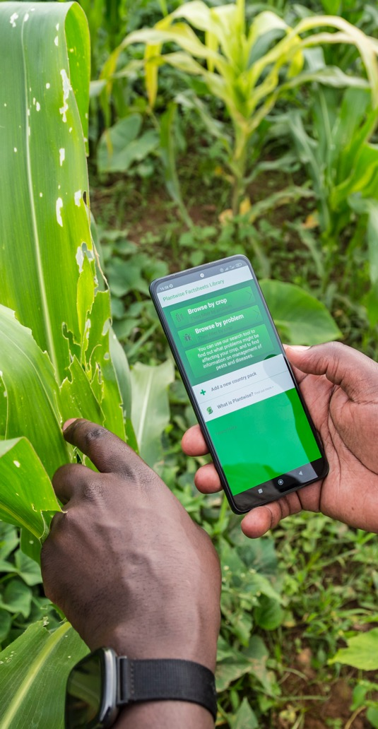
Sustainable crop production
PlantwisePlus will achieve this vision by supporting countries to predict, prevent, and prepare for plant health threats in the face of a changing climate.
This ensures that smallholder farmers reduce their crop losses and produce more and safer food through sustainable crop production practices.

Slide 4
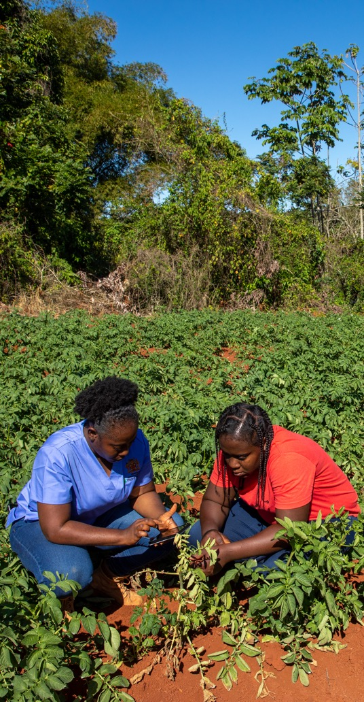



Impact pathways
Pest preparedness
Coordinating and strengthening systems for detection and response to pest outbreaks
Pesticide risk reduction
Increasing awareness of, access to, and use of affordable integrated pest management solutions
Farmer advisory
Enhancing knowledge and uptake of integrated pest management practices through responsive digital advisory tools

Slide 5
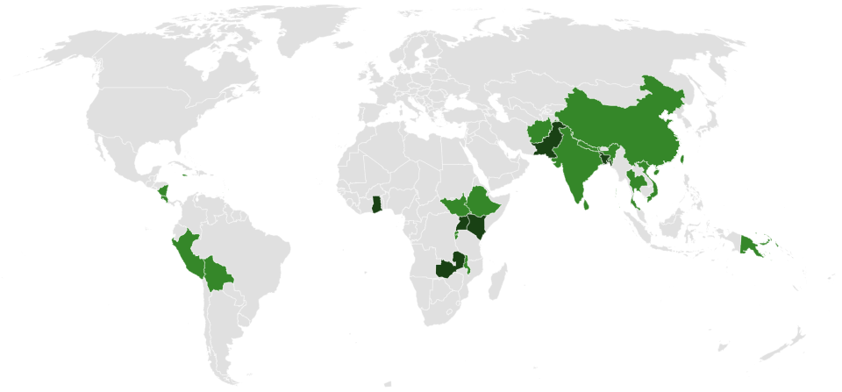
Where we work
27 PlantwisePlus countries:
21 core countries
6 focus countries
Notes:
Core offer:
Pest prioritization ​
(Horizon Scanning/Pest Risk)​
Digital tools​
Plant clinic approach​
Focus offer:
Core plus:​
Pest prevention and management plans​
Pesticide alternatives​
Inc. classical and augmentative biocontrol options
Agro-input dealer training/licensing schemes ​
Agri-business development

Slide 6




Theory of change
CHALLENGE
IF
THEN
BECAUSE
VISION
Smallholder farmers lack reliable information about pest threats, are unaware of pesticide risks and have limited access to advice on lower-risk crop production practices
National and regional authorities are supported to coordinate and implement prioritised pest prevention actions and climate-resilient pest management plans.
Pest, threats and outbreaks will be mitigated through stronger national and regional plant health systems.
Relevant stakeholders will be better able to predict, prevent and prepare for priority pests and share alerts and advice with smallholder farmers
Smallholder farmers are empowered to manage evolving plant health threats, increase their incomes, improve food security and safety, and reduce biodiversity loss
PEST
PREPARDNESS
Stakeholders are supported to learn about pesticide risks, and to identify lower-risk alternatives such as sustainable biocontrol and biopesticides
Smallholder farmers will apply safer crop production practices
Stakeholders will better understand IPM practices and will be empowered to promote these alternatives
PESTICIDE RISK REDUCTION
Agri-service providers are supported to improve their advisory capabilities on IPM through digital and non-digital approaches, and to pursue related income generating opportunities.
More smallholder farmers will adopt sustainable, crop production practices, producing more food.
Agri-service providers will have better knowledge about IPM, and, through new business opportunities, will be empowered to support more farmers
FARMER ADVISORY

Slide 7
Where we work
27 PlantwisePlus countries:
21 core countries
6 focus countries
Notes:
Core offer:
Pest prioritization ​
(Horizon Scanning/Pest Risk)​
Digital tools​
Plant clinic approach​
Focus offer:
Core plus:​
Pest prevention and management plans​
Pesticide alternatives​
Inc. classical and augmentative biocontrol options
Agro-input dealer training/licensing schemes ​
Agri-business development

Slide 8
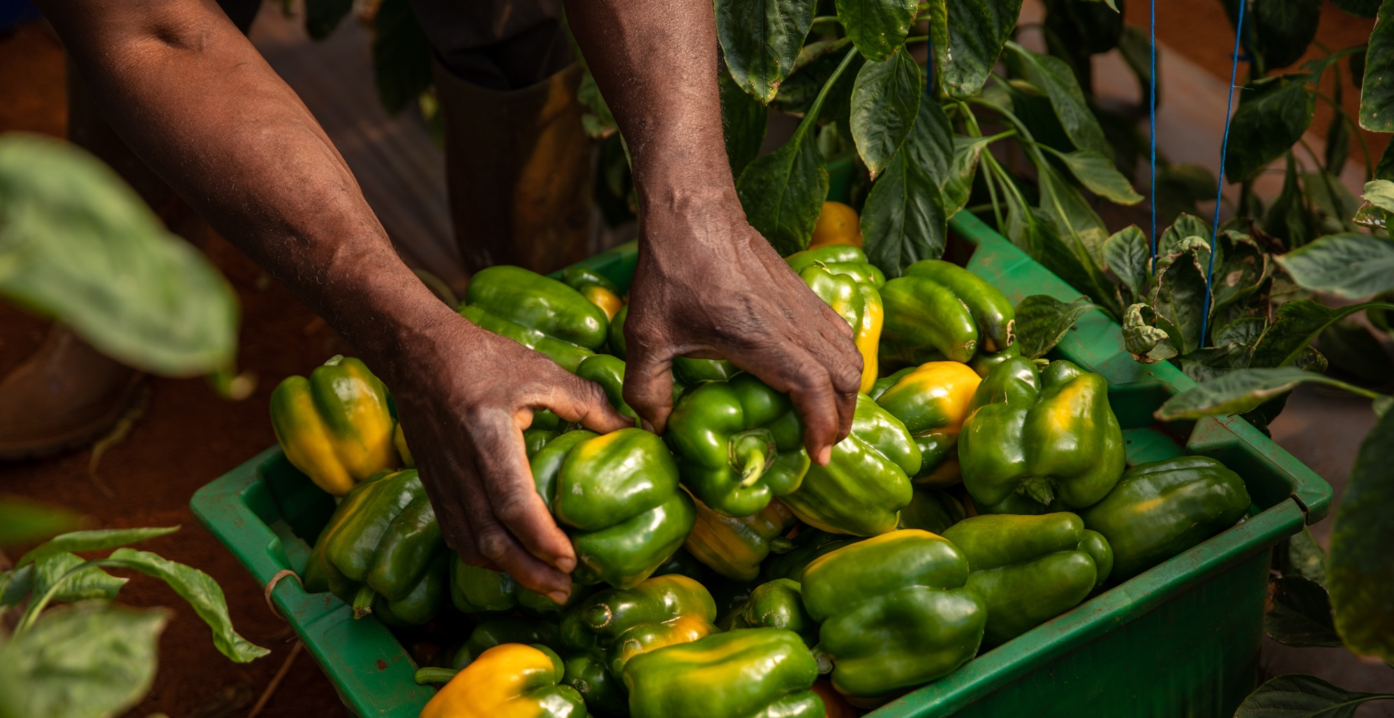
We look forward to future collaboration with our partners to support smallholder farmers around the world.

